Slide 1



IT Impact V1.0 Bootcamp

Slide 2
THE TEAM
Yahiya Mabrouk
Med Amine Belhassine
Aziz Sridi
Oussema Ben Ouanes
Rochdi Ferjaoui
2

Slide 3

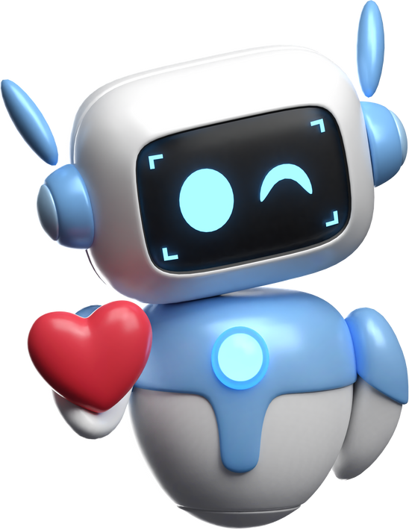
Why Every Second Matters
Every year, millions face life-threatening emergencies — and many don’t get help in time.
1.3 billion people live with disabilities that put them at risk of sudden health crises.
15 million strokes occur annually — 5 million lead to permanent disability.
50 million epilepsy patients suffer from unpredictable seizures.
3 million adults are hospitalized due to falls each year.
5 million lives are lost to heart disease — the world’s #1 killer.
These numbers aren't just statistics — they represent lives that could be saved with faster intervention.
3

Slide 4


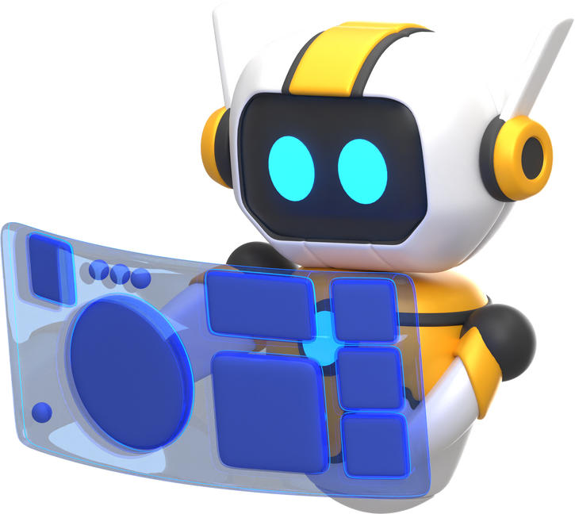
The Vision
“Imagine a world where AI can detect life-threatening emergencies and call for help in seconds.”
That’s exactly what we’re building.
ICU is a smart system that uses artificial intelligence to monitor, detect, and react — automatically — during critical health emergencies.
4

Slide 5

Meet ICU
ICU (Intelligent Care Unit) is an AI-powered system that detects emergencies in real-time — including:
Seizures
Cardiac distress
Sudden falls
It works continuously through video monitoring to make sure no emergency goes unnoticed.
5

Slide 6
How It Works
ICU uses a layered system of intelligent agents:
Pose Estimation Agent – Tracks body movement and position
Detection Agent – Identifies emergency patterns
Safe Position Agent – Detects vulnerable/unconscious positions
Emergency Response Agent – Automatically triggers alerts
Discord Call Agent – Instantly notifies caregivers or emergency services
Everything starts with a camera — and ends with action when it matters most.
The Following diagram is Explaining these layers in an easy way
6

Slide 7
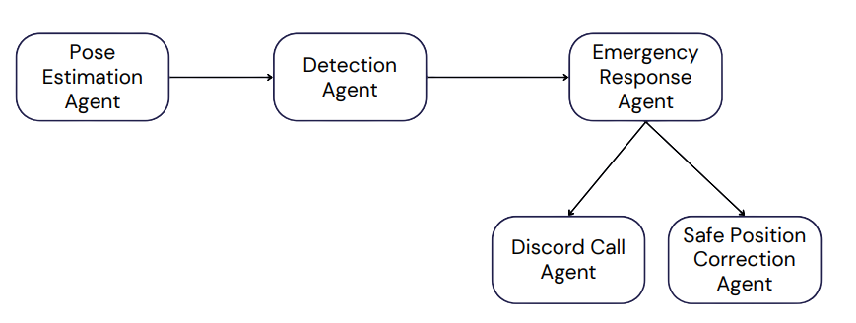
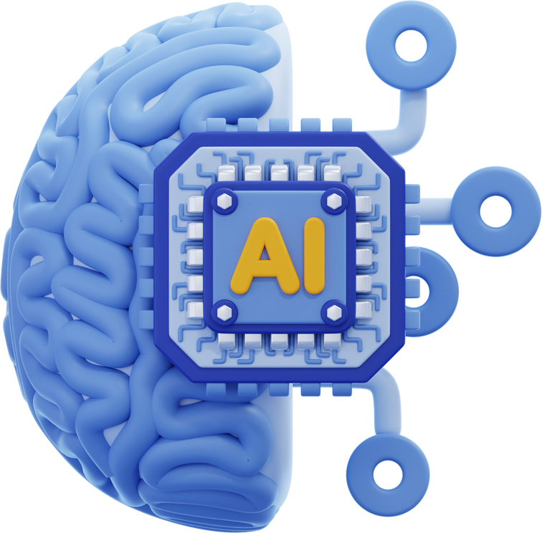
7

Slide 8
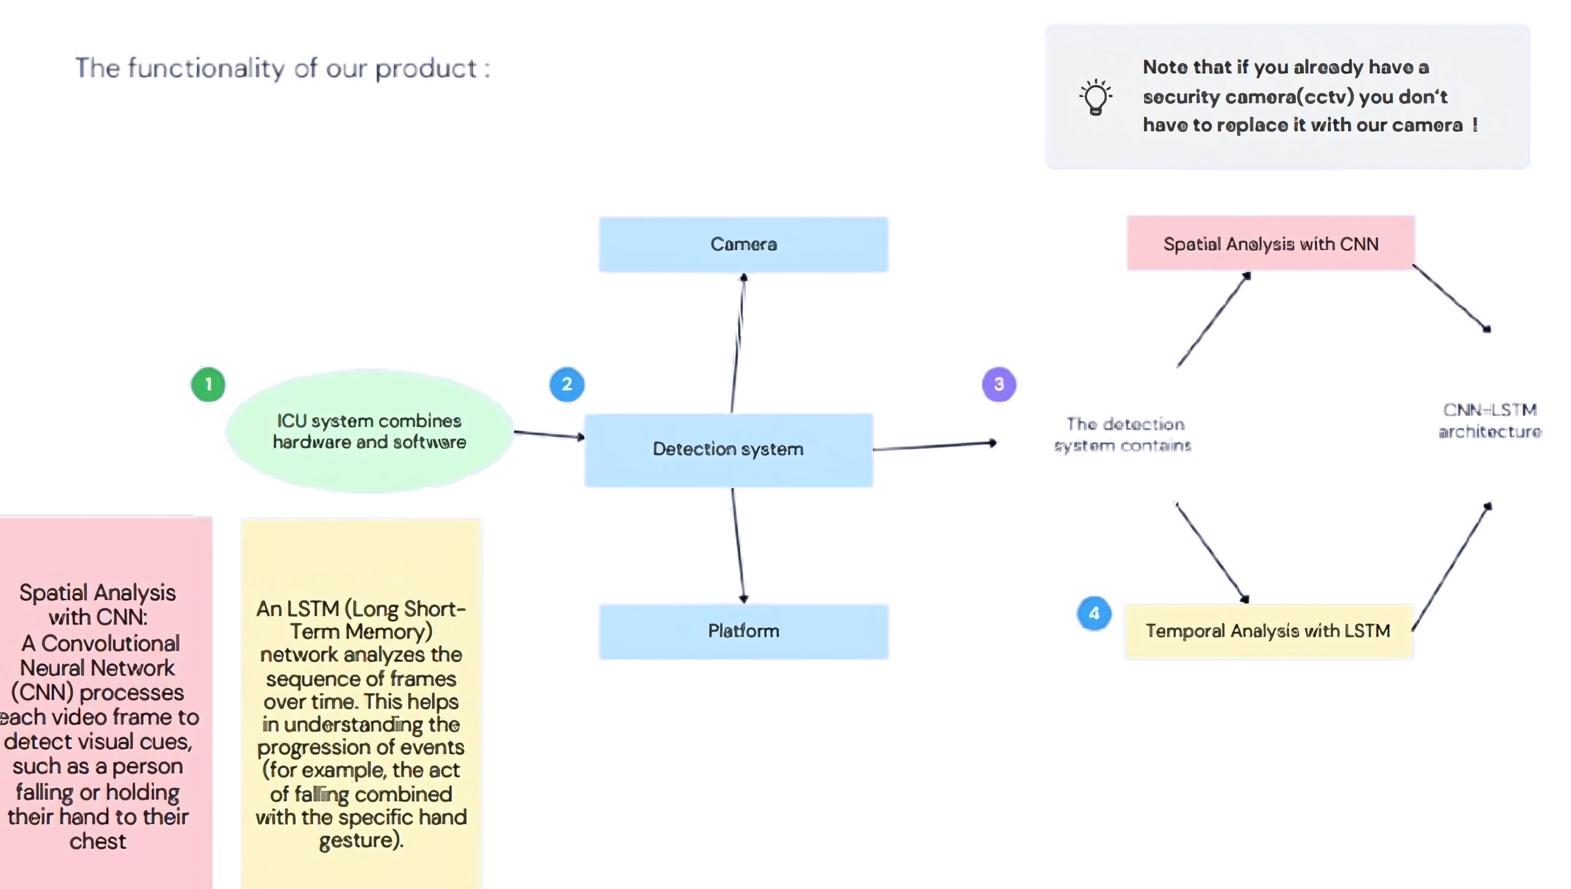
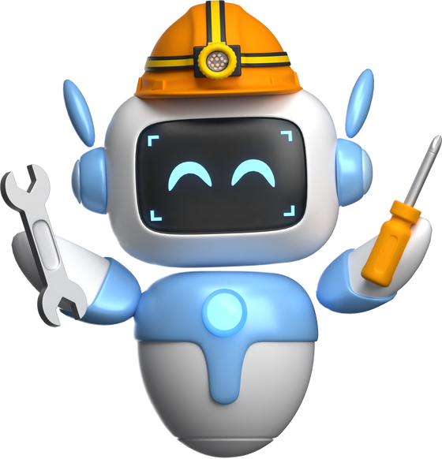
The Technology Behind It
The detection system contains
CNN-LSTM architecture
This hybrid architecture allows ICU to recognize emergencies from video — just like a human would.
8

Slide 9
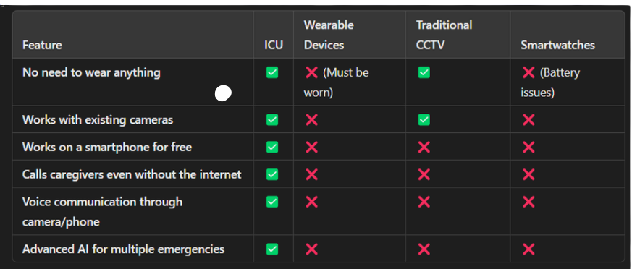
Why Us ?
9

Slide 10
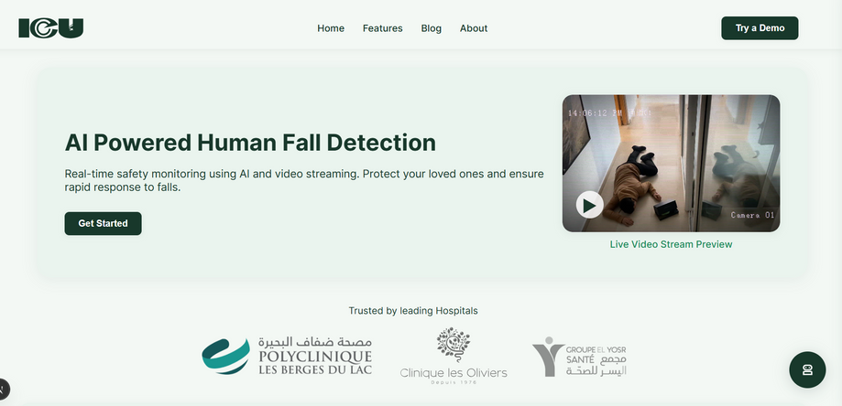
The Platform
ICU is accessible through a web and mobile app.
Real-time monitoring
Automatic alerts to caregivers or emergency services
Heart rate anomaly detection
No wearable devices required
A seamless, life-saving platform — always on, always watching.
10

Slide 11
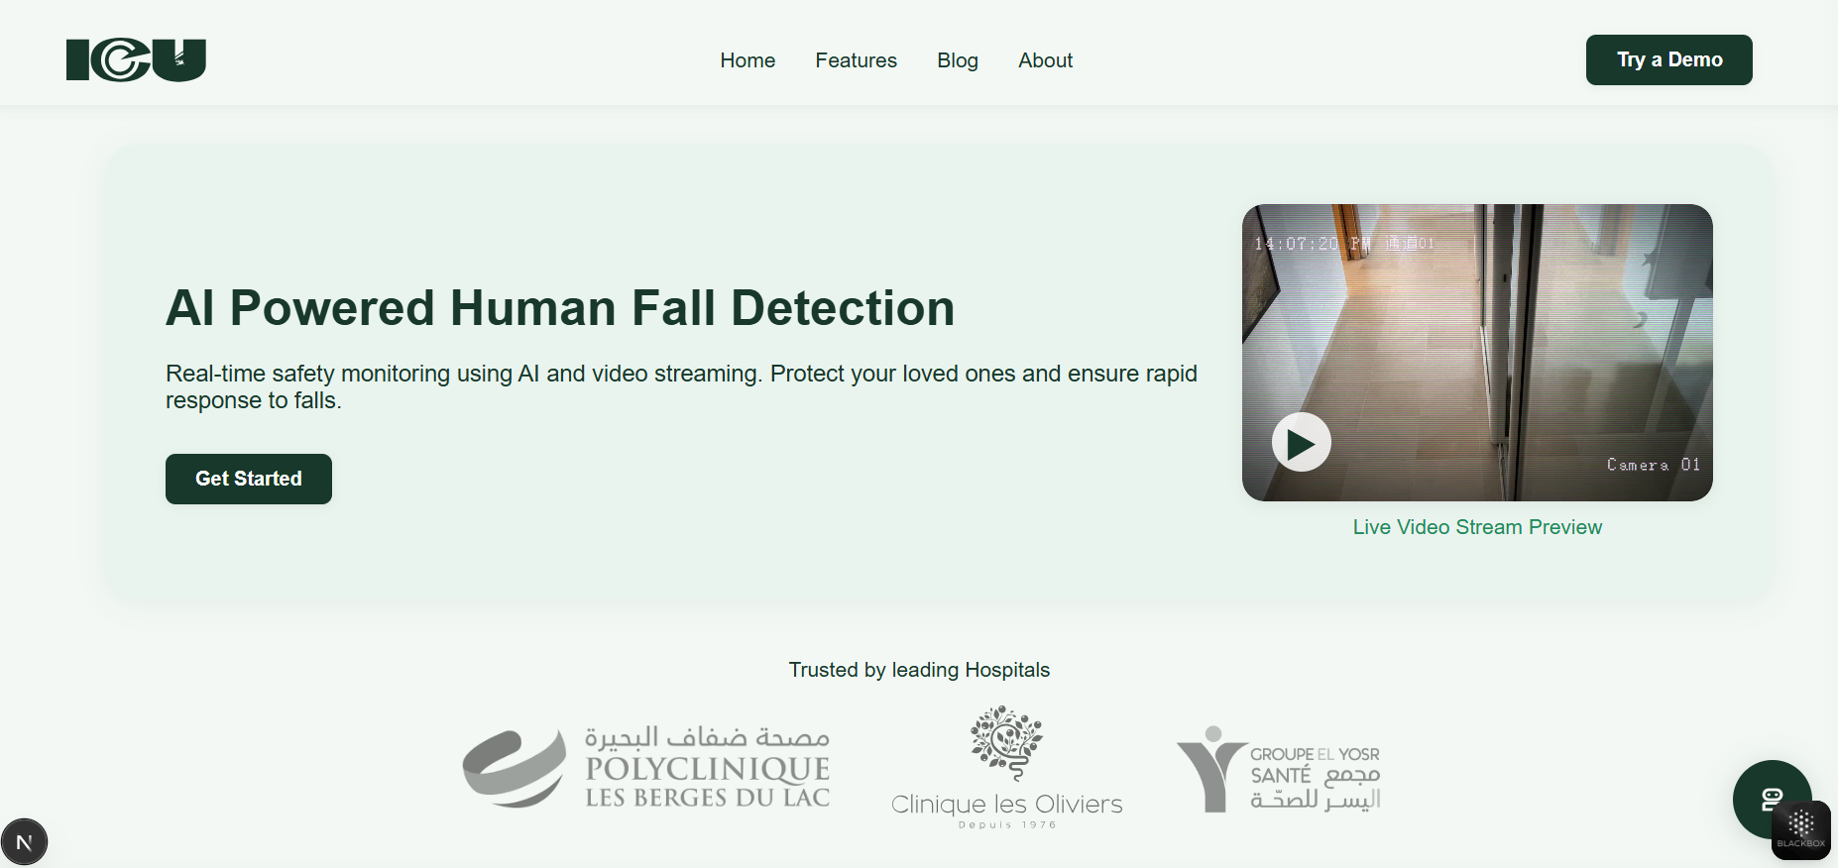
The Platform
11

Slide 12
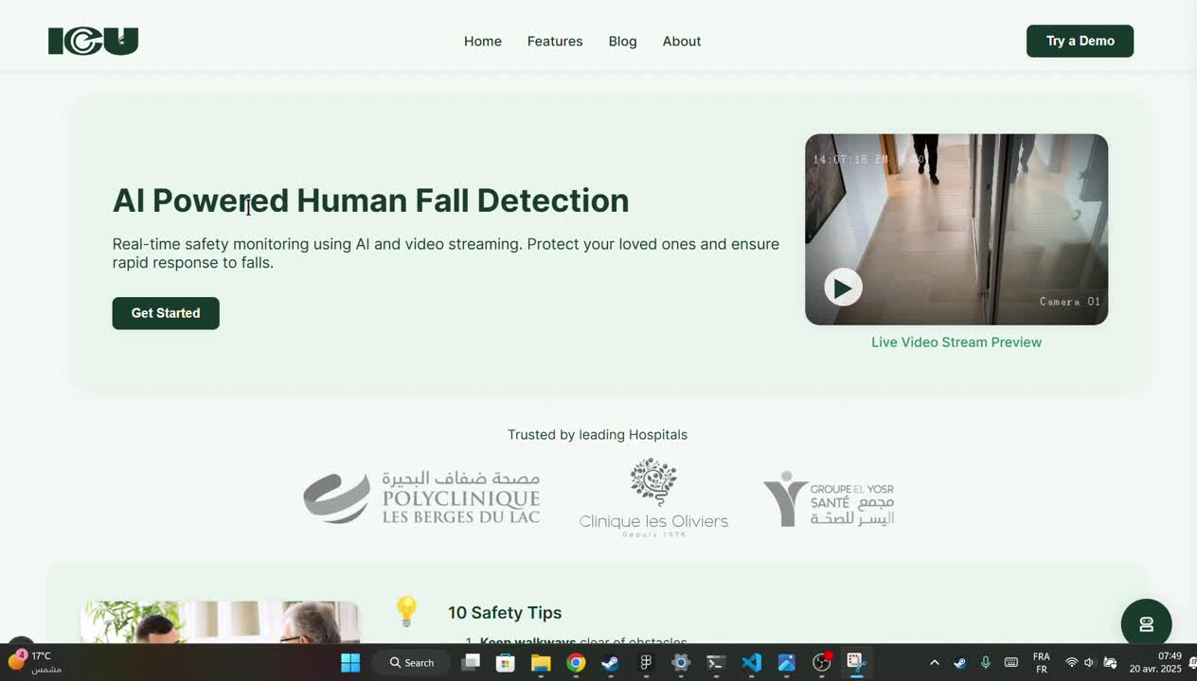
Demo
12

Slide 13

Who It's For
ICU is built for:
Seniors living alone
Epilepsy patients prone to sudden seizures
Hospitals and care centers
Caregivers needing peace of mind
Our partners include:
Healthcare providers
Insurance companies
Smart home platforms
13

Slide 14
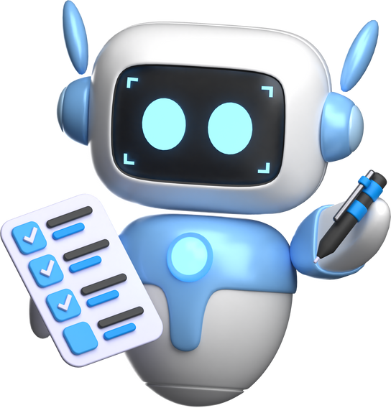
Business Model
Go-To-Market Strategy:
Sales Channels: Online store, medical device retailers
Partnerships: Hospitals, insurance providers, NGOs
Target Users: Families, elder care centers, clinics
Pricing Tiers:
Basic (Camera-only detection)
Premium (Emergency routing + multi-user support)
14

Slide 15
"AI-DRIVEN HEALTH MONITORING THAT’S ACCESSIBLE, AFFORDABLE, AND LIFE-SAVING. "
15

Slide 16
Thank you for your attention.
Let’s build a safer, smarter world — where no emergency goes unnoticed.
16

